Slide 1
Unit I - INTRODUCTION TO FORECASTING

Slide 3
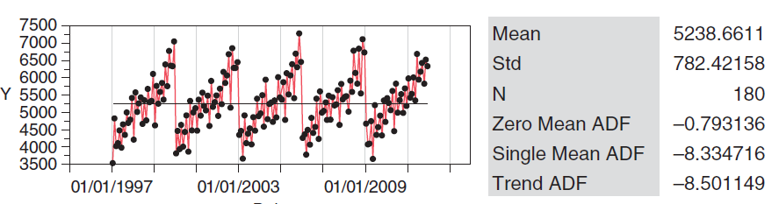
General Approach to Time Series Modelling and Forecasting
The basic steps in modeling and forecasting a time series are as follows:
1. Plot the time series and determine its basic features, such as whether trends or seasonal behavior or both are present. Look for possible outliers or any indication that the time series has changed with respect to its basic features (such as trends or seasonality) over the time period history.

Slide 4
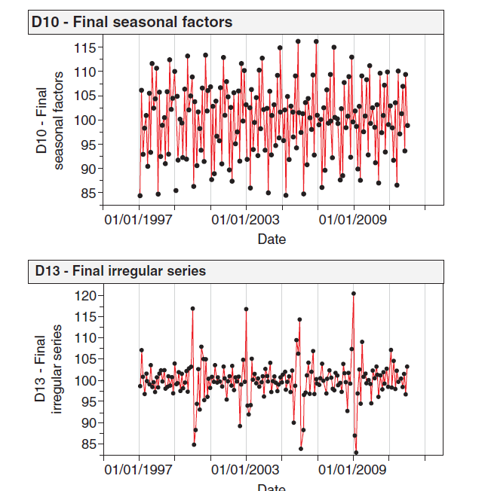
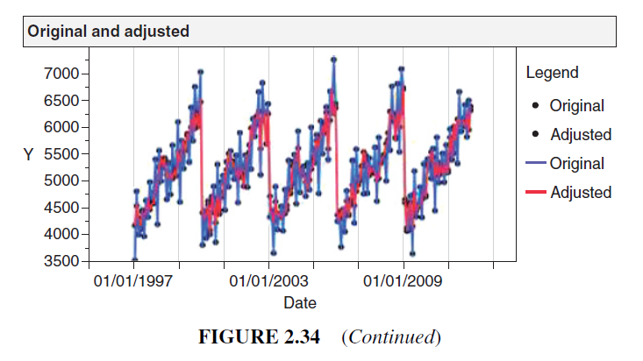
2. Eliminate any trend or seasonal components, either by differencing or by fitting an appropriate model to the data.
Also consider using data transformations, particularly if the variability in the time series seems to be proportional to the average level of the series. The objective of these operations is to produce a set of stationary residuals.

Slide 5
3. Develop a forecasting model for the residuals. It is not unusual to find that there are several plausible models, and additional analysis will have to be performed to determine the best one to deploy.
Sometimes potential models can be eliminated on the basis of their fit to the historical data. It is unlikely that a model that fits poorly will produce good forecasts.
4. Validate the performance of the model (or models) from the previous step. This will probably involve some type of split-sample or cross validation procedure. The objective of this step is to select a model to use in forecasting

Slide 6
5. Also of interest are the differences between the original time series yt and the values that would be forecast by the model on the original scale.
To forecast values on the scale of the original time series yt, reverse the transformations and any differencing adjustments made to remove trends or seasonal effects.
6. For forecasts of future values in period T + 𝜏 on the original scale, if a transformation was used, say, xt = ln yt,

Slide 7
7. If prediction intervals are desired for the forecast (and we recommend doing this), construct prediction intervals for the residuals and then reverse the transformations made to produce the residuals as described earlier.
8. Develop and implement a procedure for monitoring the forecast to ensure that deterioration in performance will be detected reasonably quickly. Forecast monitoring is usually done by evaluating the stream of forecast errors that are experienced.

Slide 8
Step-by-Step Guide to Modeling Time Series Data Using Linear Regression
Problem Statement
Objective: Develop a forecasting model for airline passenger numbers using time series data and linear regression.
Data: Historical airline passenger data, collected monthly.
Step 1: Import Libraries and Load Data
# Importing the Required libraries
import pandas as pd
import numpy as np
import matplotlib.pyplot as plt
from sklearn.model_selection import train_test_split
from sklearn.linear_model import LinearRegression
from sklearn.metrics import mean_squared_error
# Loading the dataset from the URL
url = 'https://raw.githubusercontent.com/jbrownlee/Datasets/master/airline-passengers.csv'
data = pd.read_csv(url, parse_dates=['Month'], index_col='Month')
data.head()
Notes:
https://www.geeksforgeeks.org/step-by-step-guide-to-modeling-time-series-data-using-linear-regression/

Slide 9
Step 2: Visualize the Time Series Data
# plotting the time series data to visualize the trends or patterns
plt.figure(figsize=(10, 6))
plt.plot(data, label='Monthly airline passengers')
plt.title('Airline Passengers Over Time')
plt.xlabel('Date')
plt.ylabel('Number of Passengers')
plt.legend()
# saving the plot as an image
plt.savefig('timeseries_plot.png')
plt.show()

Slide 10
Step 3: Data Preparation for Linear Regression
# Creating the lagged features and preparing the data for linear regression
data['Month'] = data.index
data['Month'] = data['Month'].map(pd.Timestamp.toordinal)
# Defining the feature (X) and target (y) variables
X = data[['Month']]
y = data['Passengers']
# Splitting the data into training and test sets in proportion of 80% and 20% respectively
X_train, X_test, y_train, y_test = train_test_split(X, y, test_size=0.2, shuffle=False)

Slide 11
Step 4: Fitting the Linear Regression Model
# Initializing the linear regression model
model = LinearRegression()
# Training the model on the training data available
model.fit(X_train, y_train)

Slide 12
Step 5: Make Predictions
# Making predictions on the testing data
y_pred = model.predict(X_test)
Step 6: Model Evaluation
# Evaluating the models using MSE metric
mse = mean_squared_error(y_test, y_pred)
print(f'Mean Squared Error: {mse}')

Slide 13
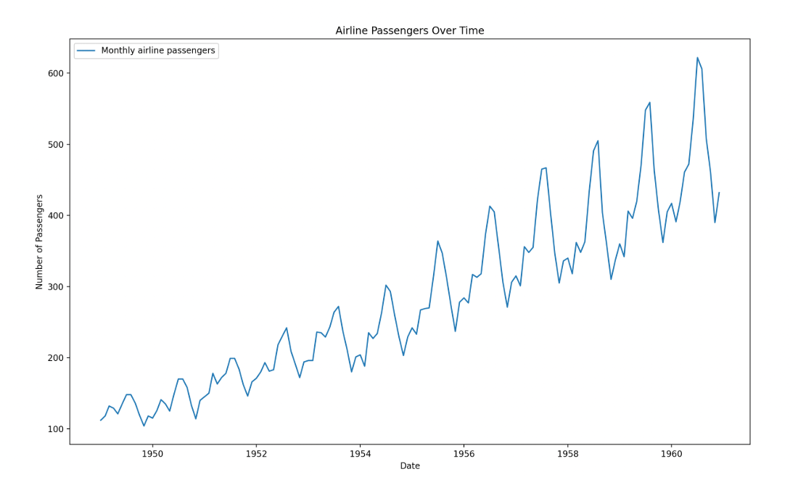
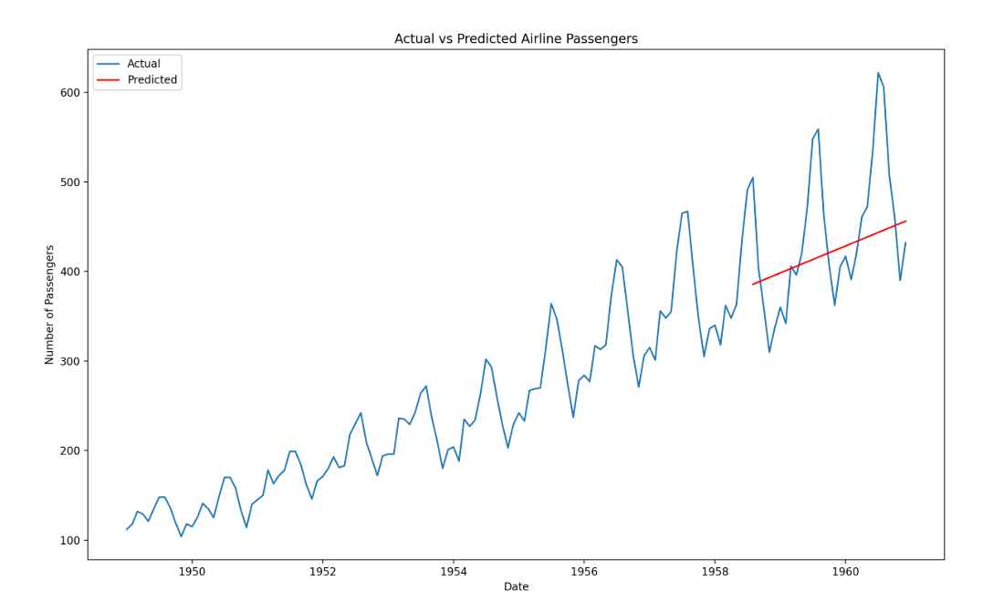
Step 7: Visualize the Results
# Plotting the actual vs predicted values inorder to visualize model performance
plt.figure(figsize=(10, 6))
plt.plot(data.index, data['Passengers'], label='Actual')
plt.plot(X_test.index, y_pred, label='Predicted', color='red')
plt.title('Actual vs Predicted Airline Passengers')
plt.xlabel('Date')
plt.ylabel('Number of Passengers')
plt.legend()
# Saving the plot as an image
plt.savefig('actual_vs_predicted.png')
plt.show()

